Slide 1
Computer Organization and Assembly Fall 2019
Lecture 12 & 13
Syeda Farwa Batool

Slide 2
Display Memory
Segment For display memory/video memory is 0xb800
We use ES (extra segment) to save video memory segment.
mov ax, 0xb800
mov es, ax
We use 2 byte (1 word) to display 1 character on screen.
1 byte for attributes of character
1 byte for ASCII of character

Slide 3
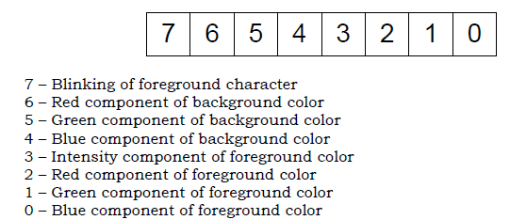
Attributes of character
Bits
For example:
if we want white color of foreground then we will ON Red [2], Green[1] and Blue[0] bits of foreground
If we want to low intensity of foreground color then OFF intensity [3] bit
if we want black color of background then we will OFF Red [6], Green[5] and Blue [4] bits of background
if we do not want to blink our character then we will OFF the Blinking bit [7]
So our final binary value of attribute byte will be: 0000111 which is 07

Slide 4
ASCII of character
‘A’ => 65 in Decimal and 41 in hex
‘Z’ => 90 in Decimal and 5A in hex
‘0’ => 48 in Decimal and 30 in hex
‘9’ => 57 in Decimal and 39 in hex
‘a’ => 97 in Decimal and 61 in hex
‘z’ => 122 in Decimal and 7A in hex
‘ ’[space] => 32 in Decimal and 20 in hex

Slide 5
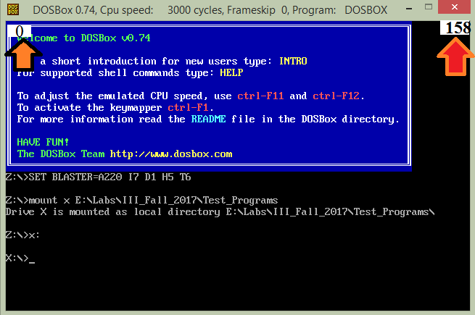
Dimensions of Screen
There are total 80 column each row, value of each cell has 2 bytes = 80*2 =160 bytes in each row of video memory.
There are total 25 rows in your screen.
Total 25 rows
0 to 24
24*160
=3840
24*160+158
=3998

Slide 6
Question # 1
Write a subroutine that receives a null terminated string address and then prints that string on screen [starting location of screen is 0].
For example:
Str: db “Pakistan”, 0

Slide 7
Question 2
Write a subroutine that clears whole screen.

Slide 8
Number printing in assembly
If I want to print 10 on screen
So, does following code works?
mov bh, 07
mov bl, 10
mov ax, 0xb800
mov es,ax
mov [es:0] , bx
So, we need to print a number digit by digit.
Because it will print a characters whose ASCII value is 10.

Slide 9
Number printing Algorithm
Divide the number by base (10 in case of decimal)
The remainder is its right most digit
Convert the digit to its ASCII representation (Add 0x30 to the remainder in case of decimal)
Save this digit on stack
If the quotient is non-zero repeat the whole process to get the next digit, otherwise stop
Pop digits one by one and print on screen left to right

Slide 10
DIV
Div
Reminder is in DX
mov dx,0 ; clear dividend, high
mov ax, 8003h ; dividend, low
mov cx, 100h ; divisor
div cx
; AX = 0080h, DX = 3

Slide 11
Screen location calculation
Because each value of column contain 2 bytes
Screen location be calculated with the following formulae.
location = ( hypos * 80 + epos ) * 2
Because each row 80 columns
column number of desired row
Row number [0-24]

Slide 12
MUL
Mul
For Unsigned number
The Carry flag indicates whether or not the upper half of the product contains significant digits.
val1 WORD 2000h
val2 WORD 100h
.code
mov ax, [val1]
mov bx , [val2]
mul bx ; DX:AX = 00200000h, CF=1

Slide 13
Question # 3
Write a subroutine that receives a null terminated string address, row number and column number, then it prints that string on screen on given location.
For example:
Str: db “Pakistan”, 0
Row: db 10
Col : db 5

